Slide 1
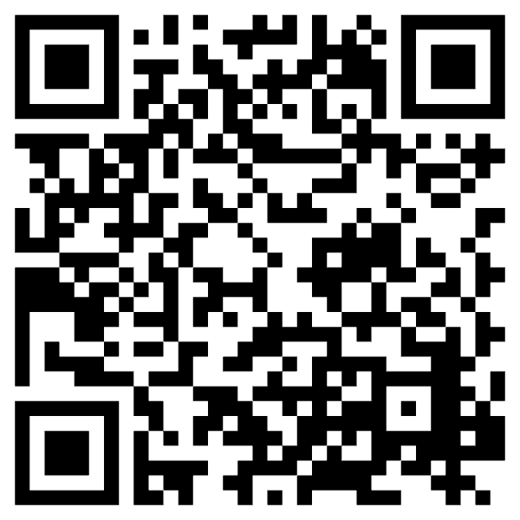

Home learning and keeping your child safe online
Interested in being a parent governor?
Scan the QR code or speak to Amy or David for more information.
Parent consultations next week Monday and Tuesday.
Book on the Arbour app
Scan QR code for instructions.
Kelsie Hawes
Assistant Headteacher

Slide 2
Use of technology in school
Used as a learning aid
Incorporated purposefully into lessons
Not used for play
Filtering – Websites are blocked from school internet
Monitoring – Senso school monitoring system. Captures websites and keystrokes. Checked regularly by the DHT, direct alerts sent to DHT.

Slide 3

Smartphone use in schools
Enfield policy of no smartphones allowed in schools - primary and secondary
‘Brick phones’
Enfield council recommend no smart phone until 14, restricted social media access until 16.

Slide 4
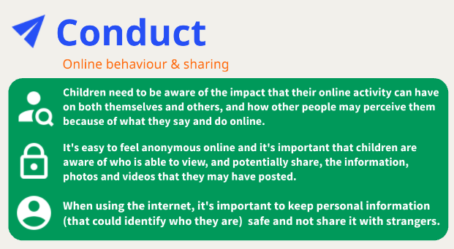

Slide 5
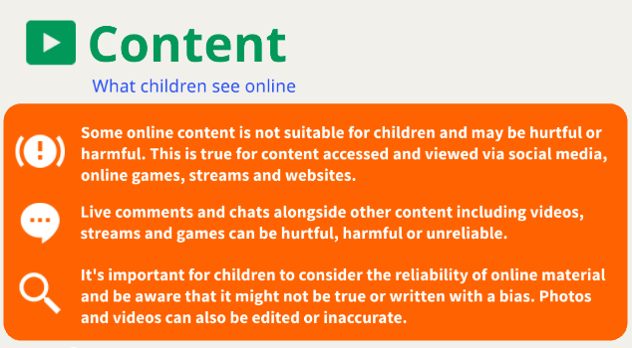

Slide 6
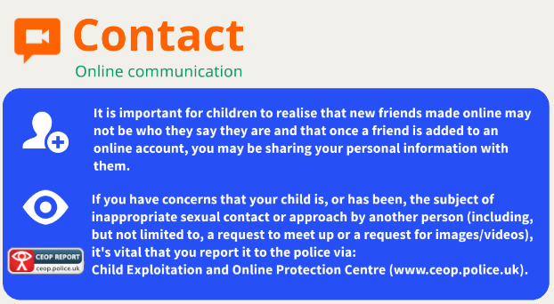

Slide 7
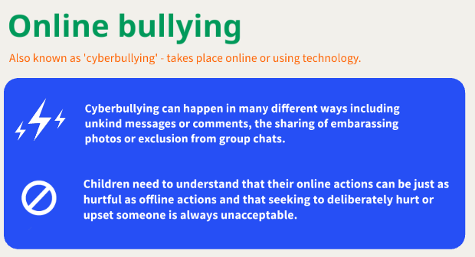

Slide 8
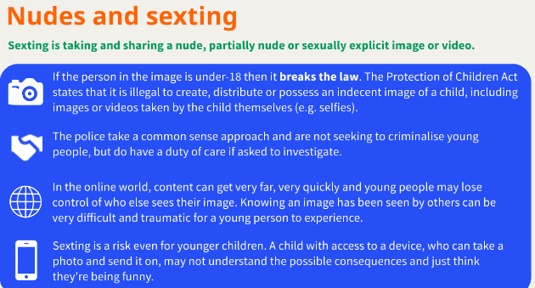

Slide 9
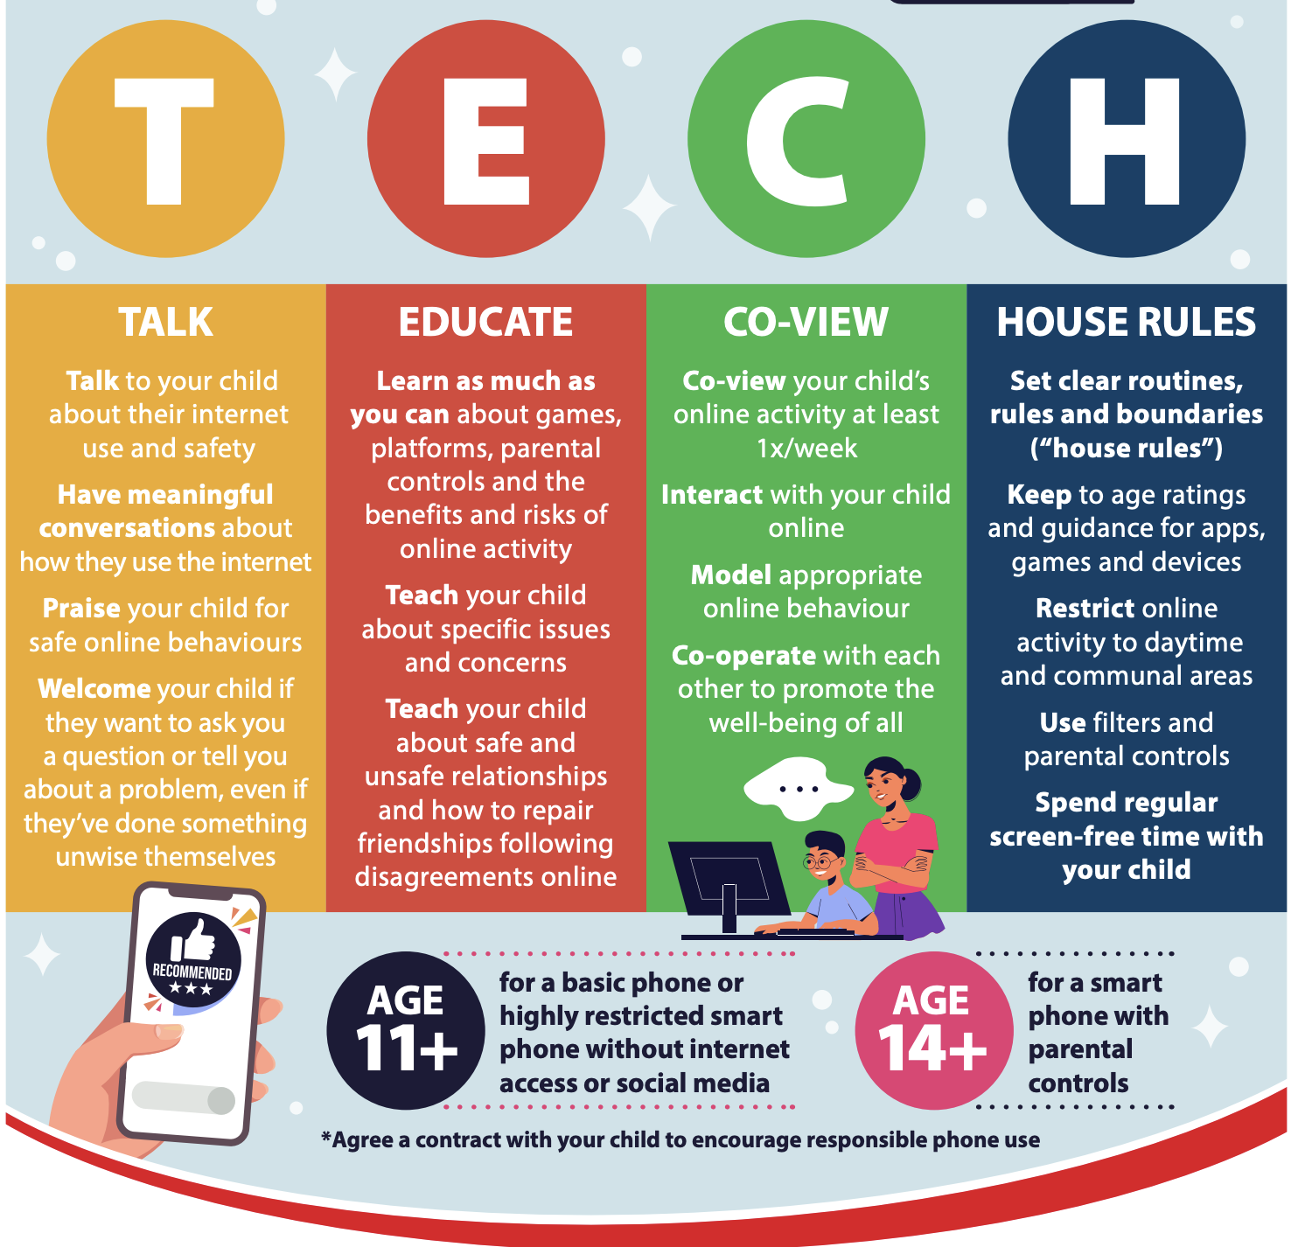

Slide 10
Home Learning
Set Tuesday, due Monday
Online:
MyMaths
Bug Club
Times Table Rockstars
Home Learning book:
Spelling

Slide 11
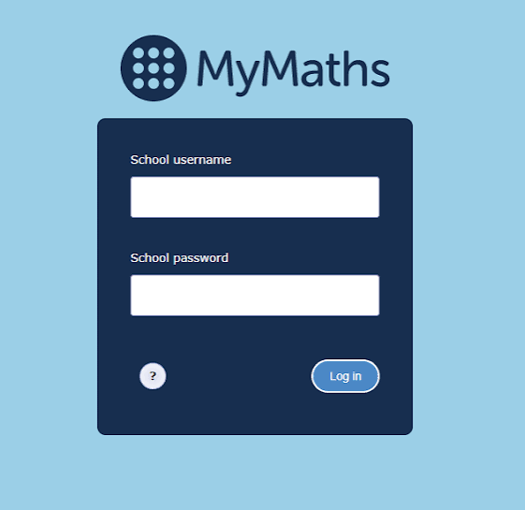
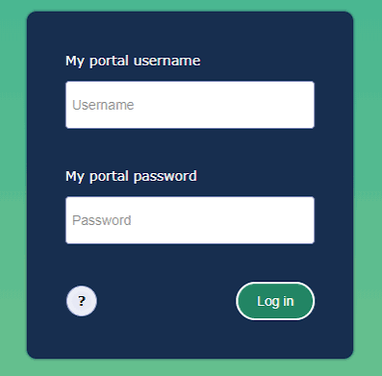
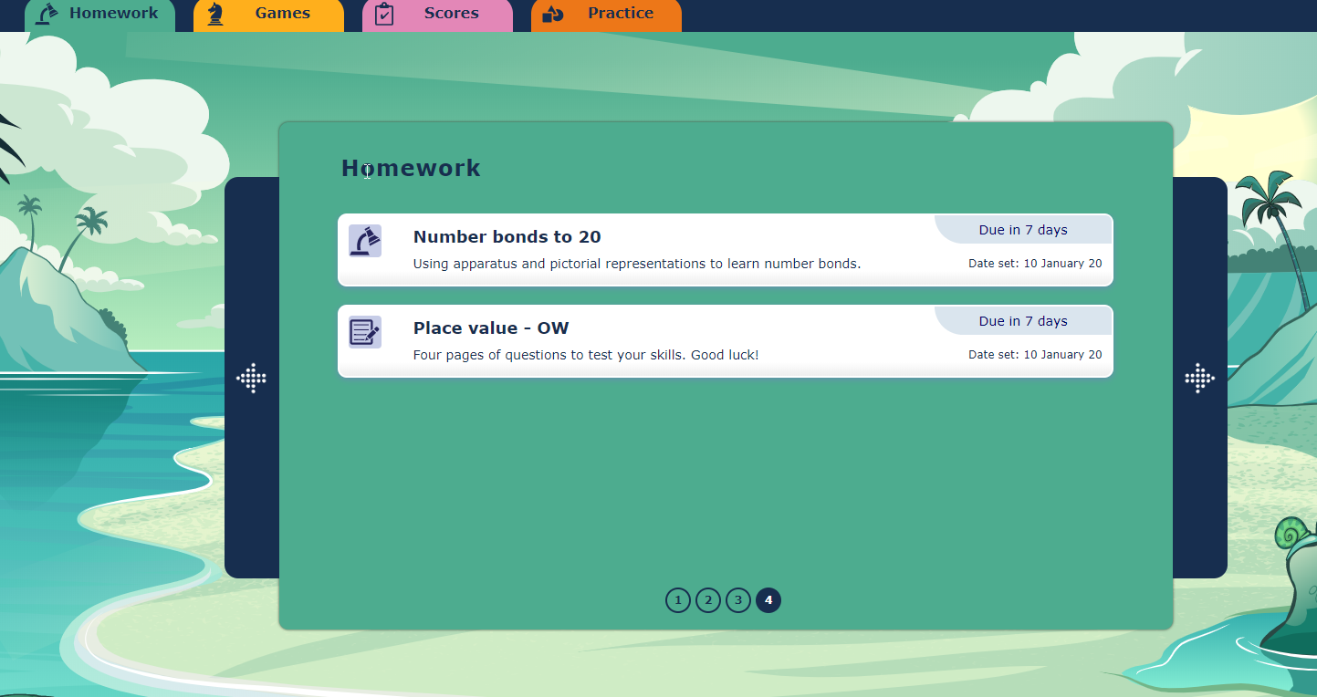
Home Learning - My Maths
Two logins
Homework tasks set

Slide 12
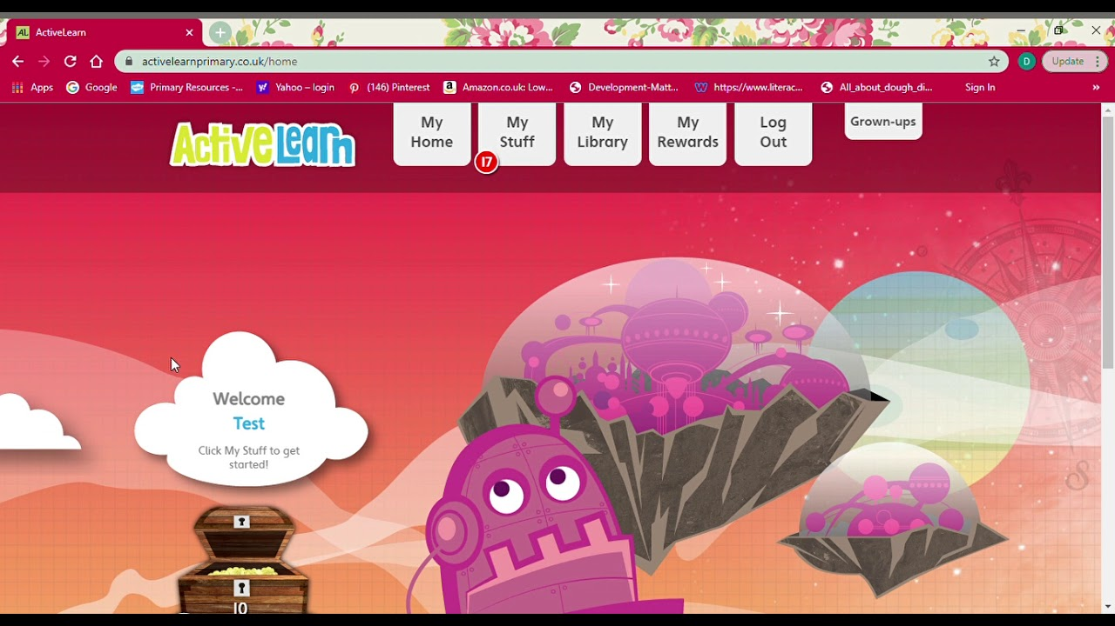
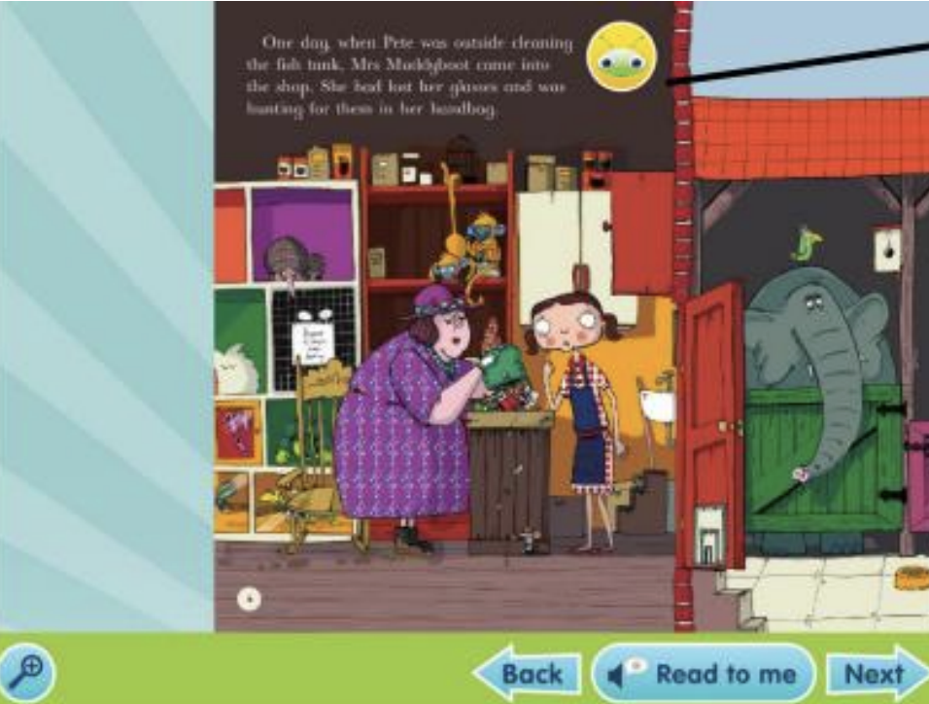
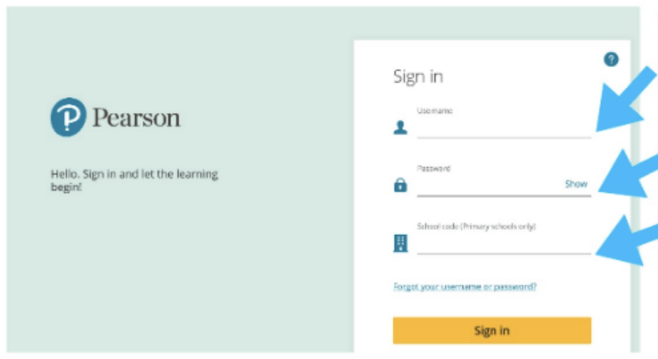
Home Learning - Bug Club
Log in
Books in ‘My Stuff’
Answer comprehension questions by clicking on the bug

Slide 13
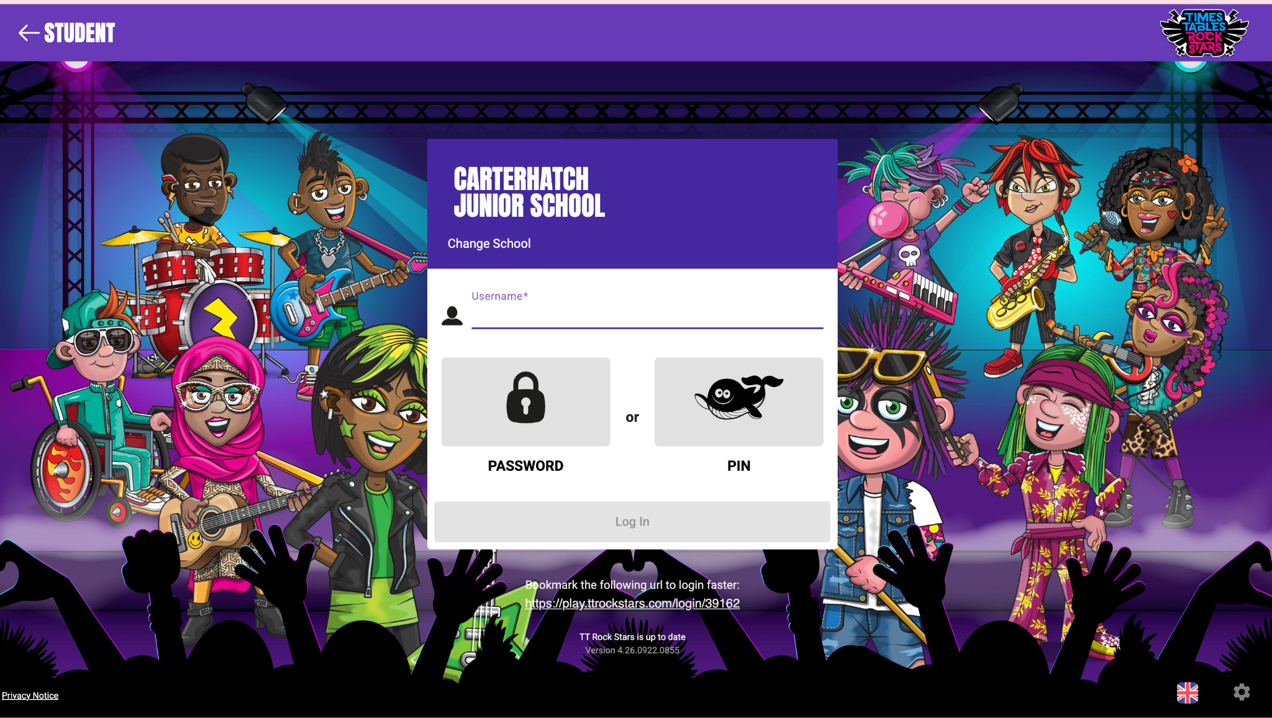
Home Learning - Times Table Rockstars
New log in
End of Year 4 multiplication check.
Children need to recall all times table facts up to 12x in 6 seconds.

Slide 14

Scan QR code for school website for instructions on how to book.
Parent consultations next week Monday and Tuesday.
Book on the Arbour app.

